Slide 1

Dheeraj Mahapatra, Shyam Kumar Soni, Anjali Singh
BTech CSE 2nd Semester

Slide 2
HOSPITAL MANAGEMENT SYSTEM
The hospital management system is a computer system that helps manage the information related to healthcare and aids in the job completion of healthcare providers effectively.
Time-saving Technology
Improved Efficiency by avoiding human errors
Cost-effective and easily manageable
Easy access to patient data with correct patient history

Slide 3

What is Tkinter?
Tkinter is the inbuilt python module that is used to create GUI applications. It is one of the most commonly used modules for creating GUI applications in Python as it is simple and easy to work with.
What is GUI?
Graphical User Interface(GUI) is a form of user interface which allows users to interact with computers through visual indicators using items such as icons, menus, windows, etc.
What is SQL?
SQL stands for Structured Query Language and is a computer language that we use to interact with a relational database. SQL is a tool for organizing, managing, and retrieving data from a computer database.

Slide 4
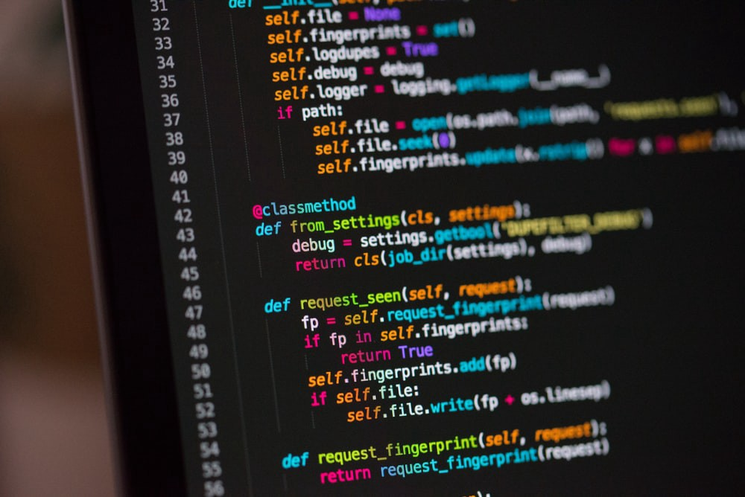
LET’S SHOWCASE THE CODE

Slide 5
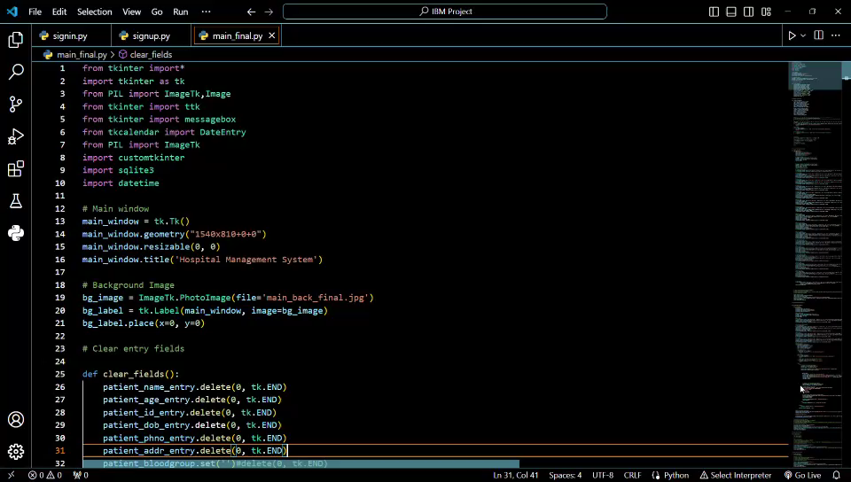
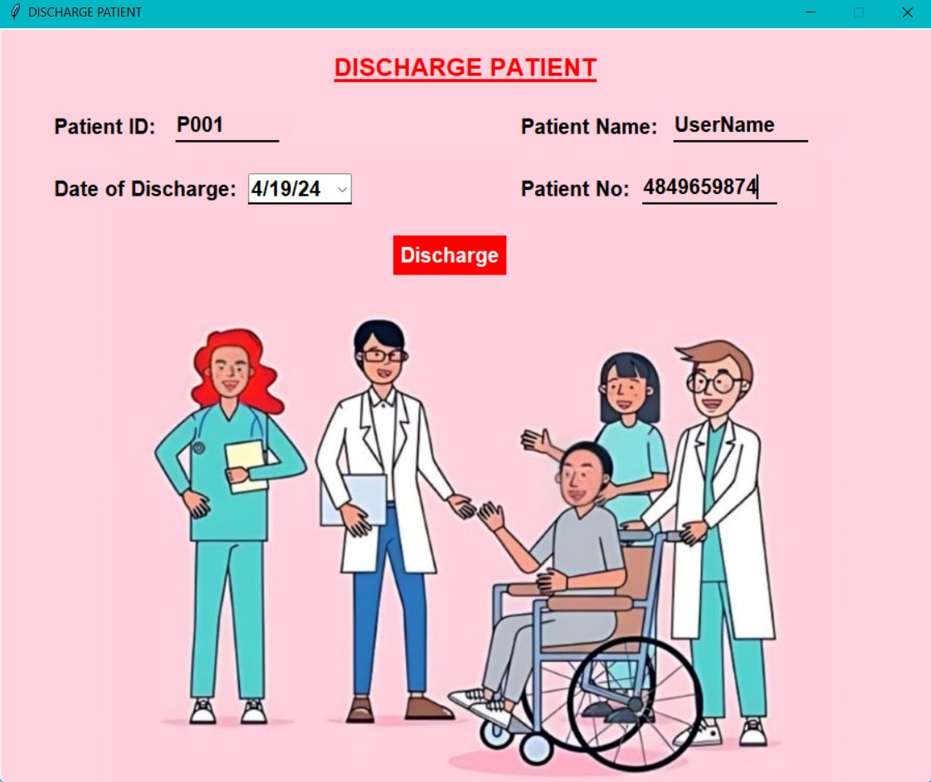
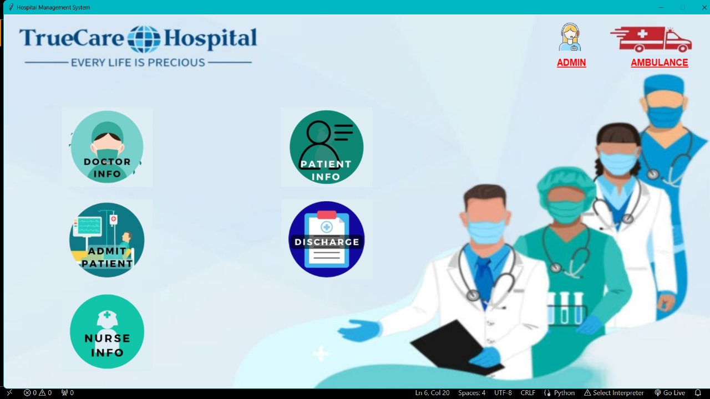
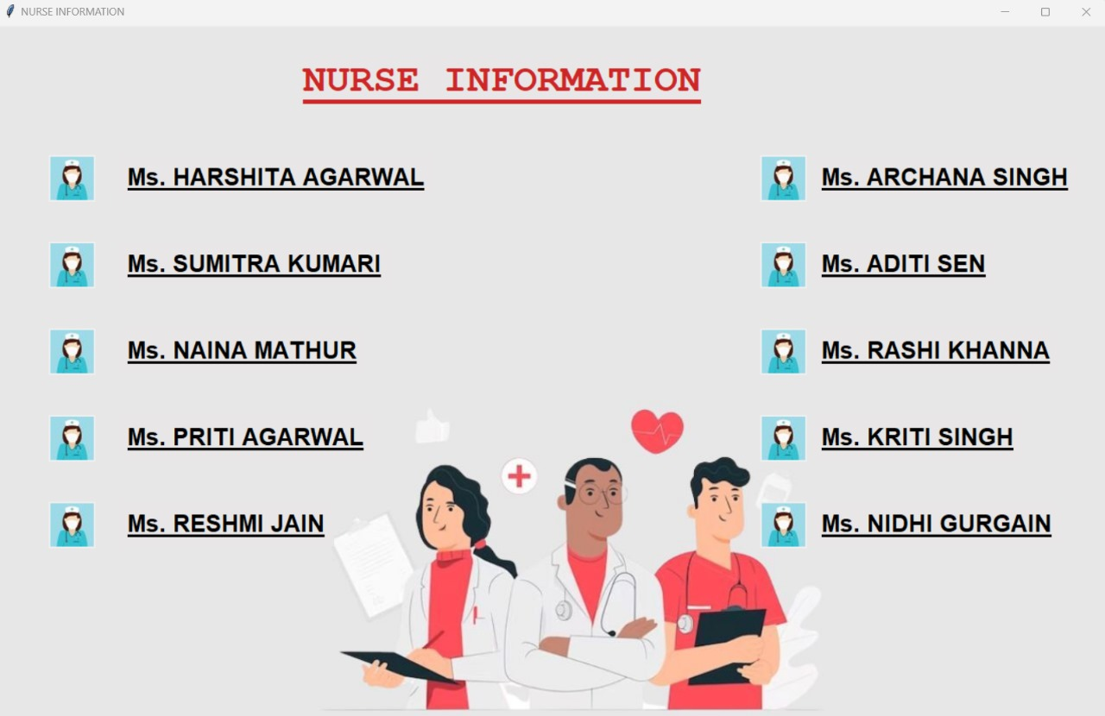
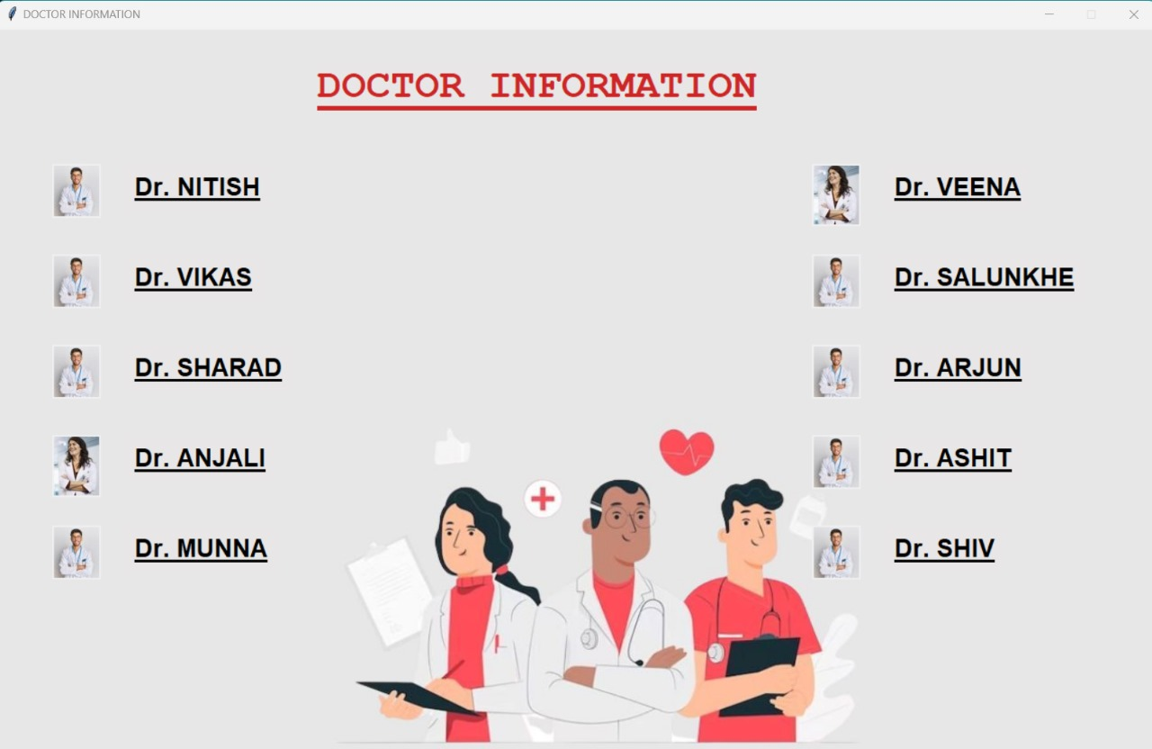
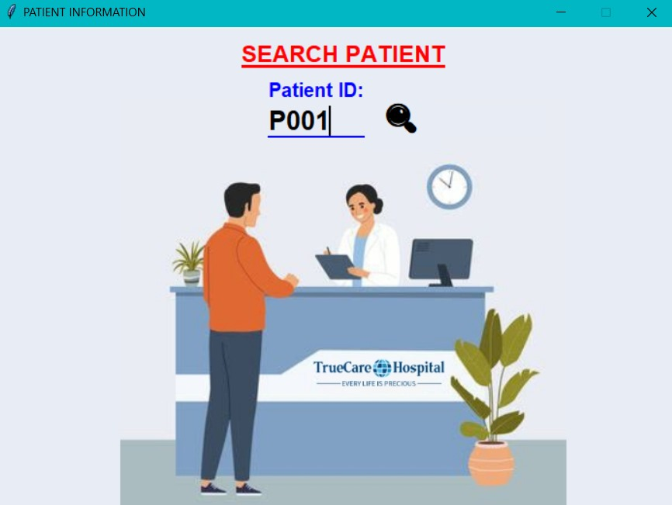
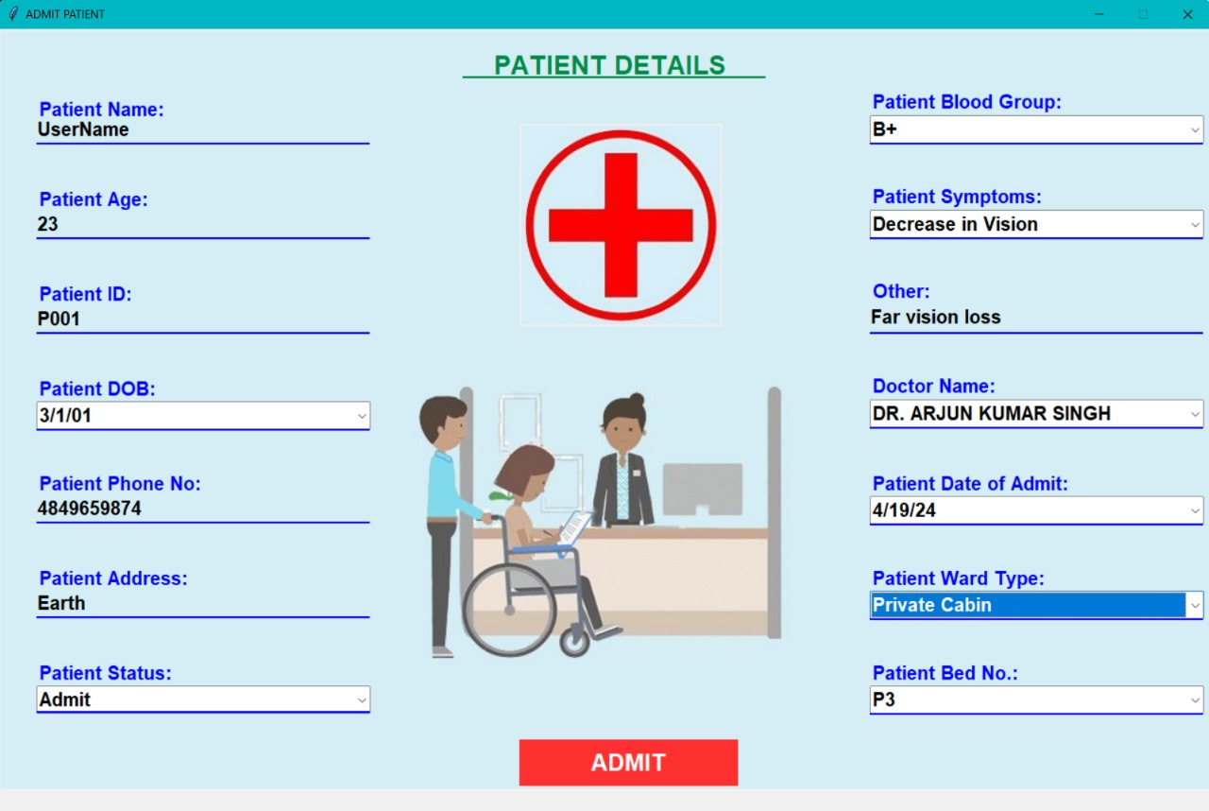
CODE
INTERFACE

Slide 6
CODE
INTERFACE

Slide 7
FIRST PAGE

Slide 9
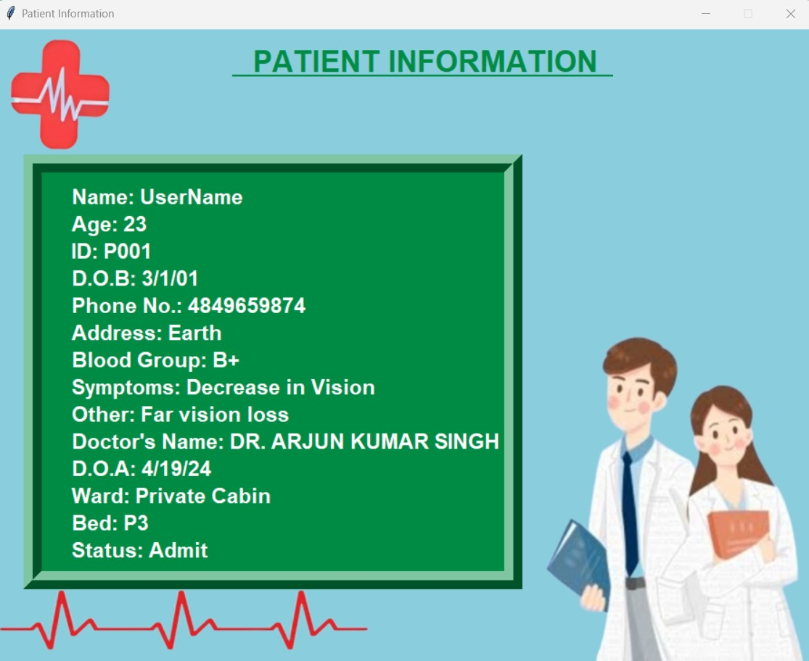

Slide 10
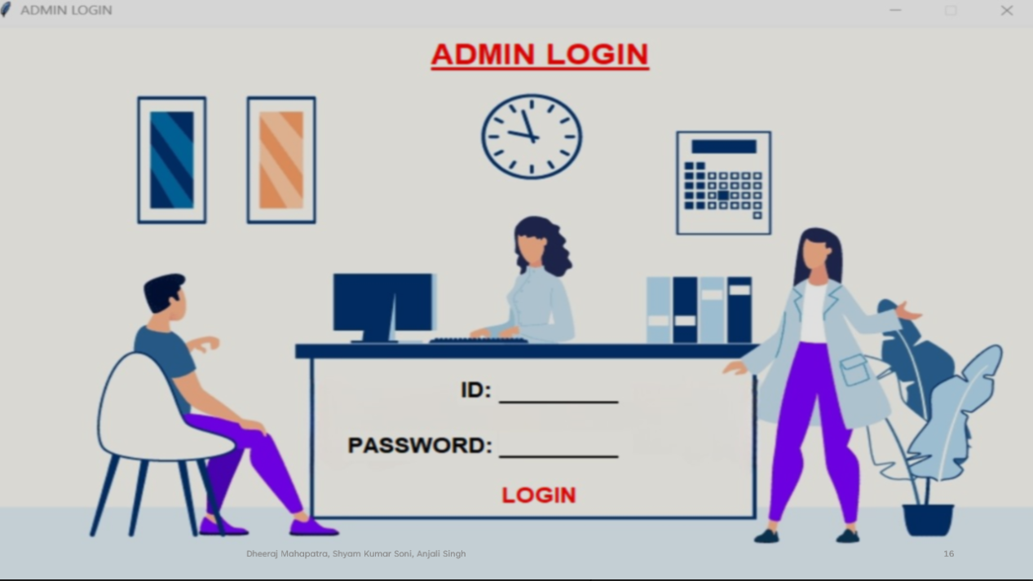

Slide 11


Slide 12
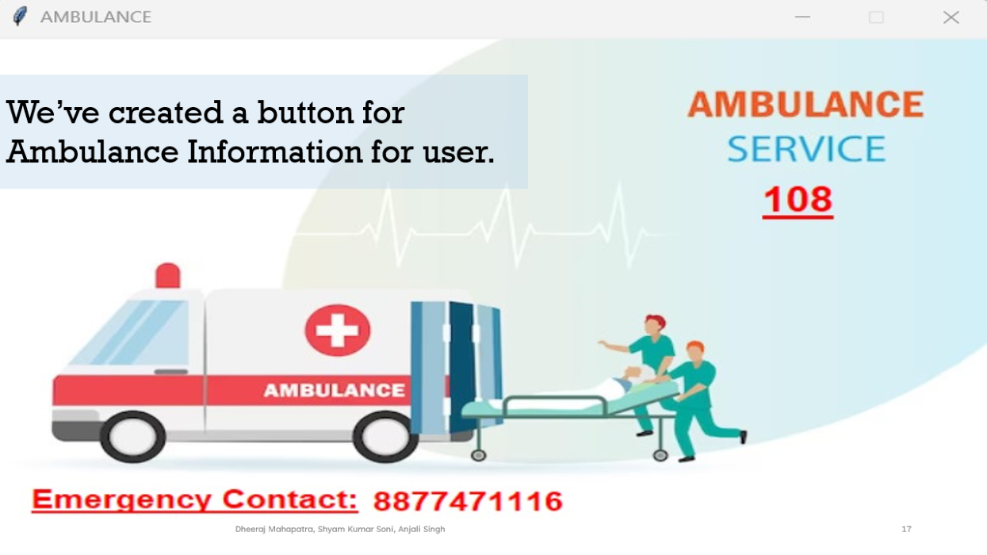


Slide 13


Slide 14
LET’S RUN THE CODE!!

Slide 15
LET’S RUN THE CODE!!

Slide 16
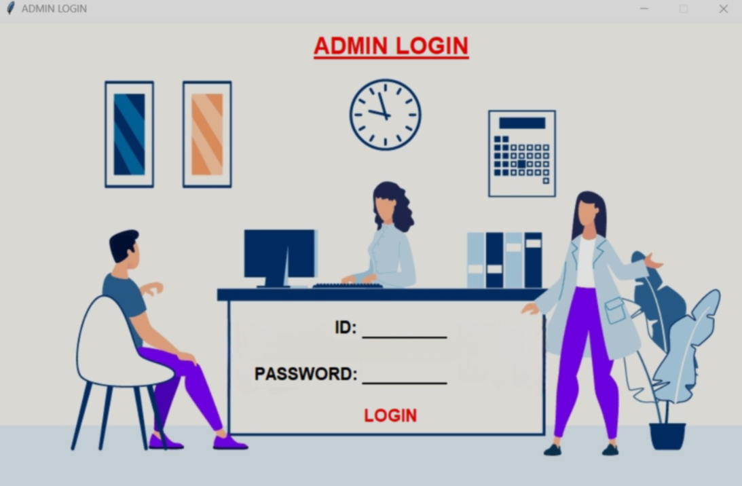

Slide 17


We’ve created a button for Ambulance Information for user.

Slide 18


Do You Have Any Question?

